Slide 1
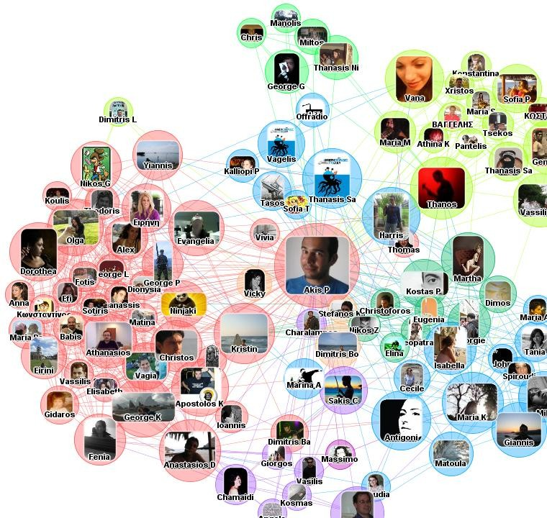
Community Discovery in Graph Networks
Dr.A.Bhuvaneswari
Asst. Professor (Sr. Grade),
School of Computer Science Engineering,
Vellore Institute of Technology, Chennai

Slide 2
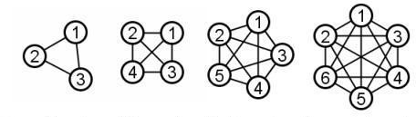
graph
nodes
G = (V, E)
edges
2

Slide 3
graph basics
node degree
deg(vi) = ki = number of neighbors
In directed graphs, we differentiate between in- and out-degree.
adjacency matrix
Αij = link between nodes i and j
0 → no link 1 → link
α → link with weight equal to α
3

Slide 4



what is a Web community?
1
Group of people sharing a common interest and creating web pages around it → these pages tend to link to each other more often than to the rest of the Web
R. Kumar, P. Raghavan, S. Rajagopalan, A. Tomkins. Trawling the web for emerging cyber- communities. Computer Networks, 31(11-16):1481-1493, 1999.

Slide 5



what is a Web community?
2
A Web community is a set of web objects (documents and users) that includes its own semantic and logical structures.
Y. Zhang, J. Xu Yu, J. Hou. Web Communities: Analysis and Construction. Springer 2006.

Slide 6
communities and graphs
Often communities are defined with respect to a graph, G = (V,E) representing a set of objects
(V) and their relations (E).
Even if such graph is not explicit in the raw data, it is usually possible to construct, e.g. feature vectors → distances → thresholding → graph
Given a graph, a community is defined as a set of nodes that are more densely connected to each other than to the rest of the network nodes.

Slide 7
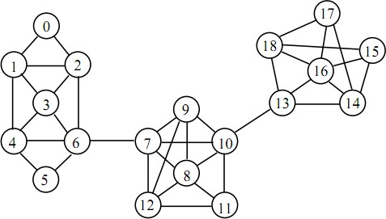
communities and graphs - example
intra-community edge
inter-community edge

Slide 8






graph cuts
Given nodes u and v of graph G = (V,E) a cut is a set of edges C ⊂ E, such that the two nodes are unconnected on the graph G΄= (V,E-C).
t
T
S
s
Using s to denote a “source” node and t to denote a “terminal” node, a cut (S,T) of G = (V,E) is a partition of V in sets S and Τ = V-S, such that s ∈ S and t∈T.

Slide 9
Modularity based Community Discovery
Dr. A. Bhuvaneswari
VIT Chennai

Slide 10
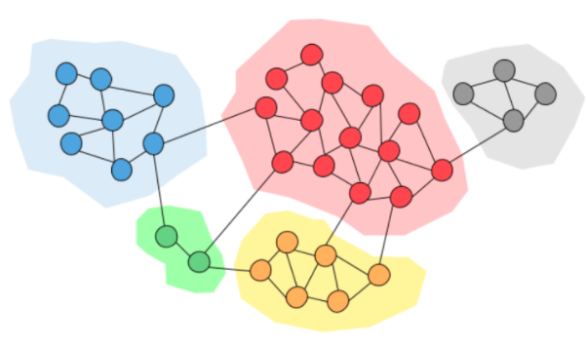
Modularity – Community Discovery
To provide a measure of the quality of a community structure, we make use of modularity.
Identify “groups embedded within a network”
Sets of nodes that interact with each other more frequently than expected by random chance.
A graph can be split into communities in numerous ways,
i.e. for each graph there are many possible community structures. In the simple case, a community structure is defined as a graph partition into a set of node sets C = {C_{i}}.

Slide 11
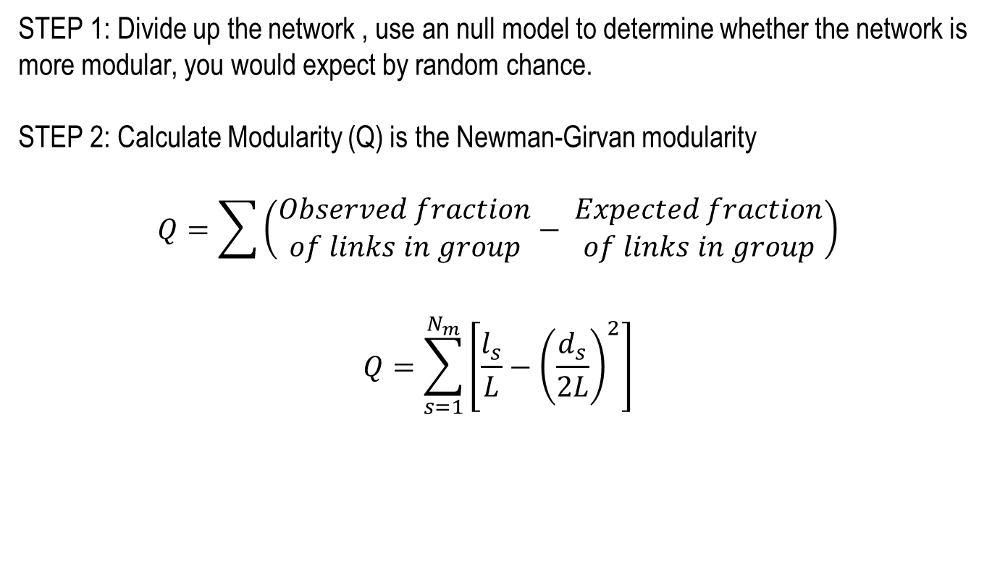
Modularity Optimization
STEP 1: Divide up the network , use an null model to determine whether the network is more modular, you would expect by random chance.
STEP 2: Calculate Modularity (Q) is the Newman-Girvan modularity
$$Q=\sum{\left(\begin{aligned}Observed fraction \\ of links in group\end{aligned}− \begin{aligned}Expected fraction \\ of links in group\end{aligned}\right)}$$
$$Q=\sum_{s=1}^{N_{m}}{\left[\frac{l_{s}}{L}−{\left(\frac{d_{s}}{2L}\right)}^{2}\right]}$$
STEP 3: Repeat with simulated annealing algorithm until modularity solution is optimized.

Slide 12
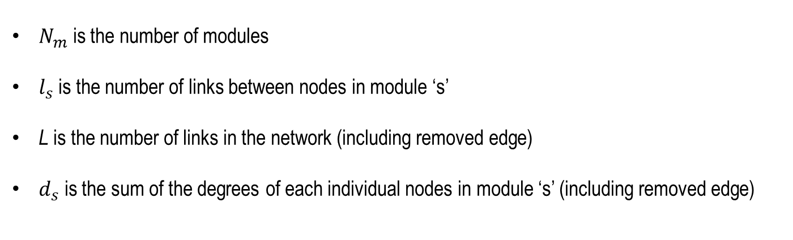
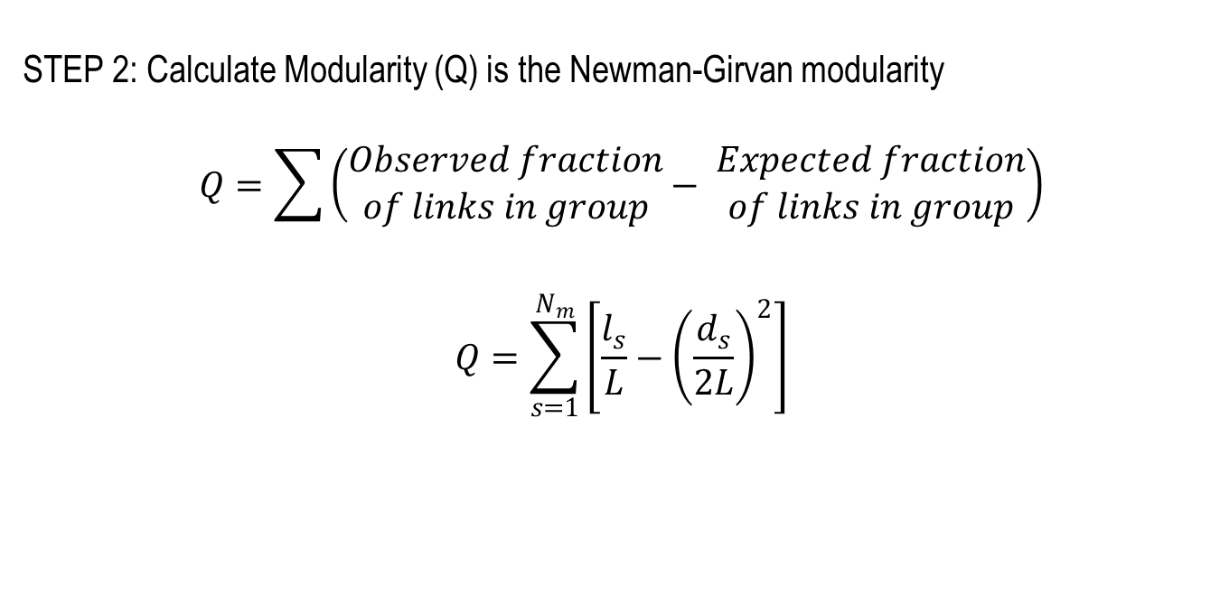
Modularity Optimization
STEP 2: Calculate Modularity (Q) is the Newman-Girvan modularity
$$Q=\sum{\left(\begin{aligned}Observed fraction \\ of links in group\end{aligned}− \begin{aligned}Expected fraction \\ of links in group\end{aligned}\right)}$$
$$Q=\sum_{s=1}^{N_{m}}{\left[\frac{l_{s}}{L}−{\left(\frac{d_{s}}{2L}\right)}^{2}\right]}$$
$N_{m}$ is the number of modules
$l_{s}$is the number of links between nodes in module ‘s’
L is the number of links in the network (including removed edge)
$d_{s}$ is the sum of the degrees of each individual nodes in module ‘s’ (including removed edge)

Slide 13
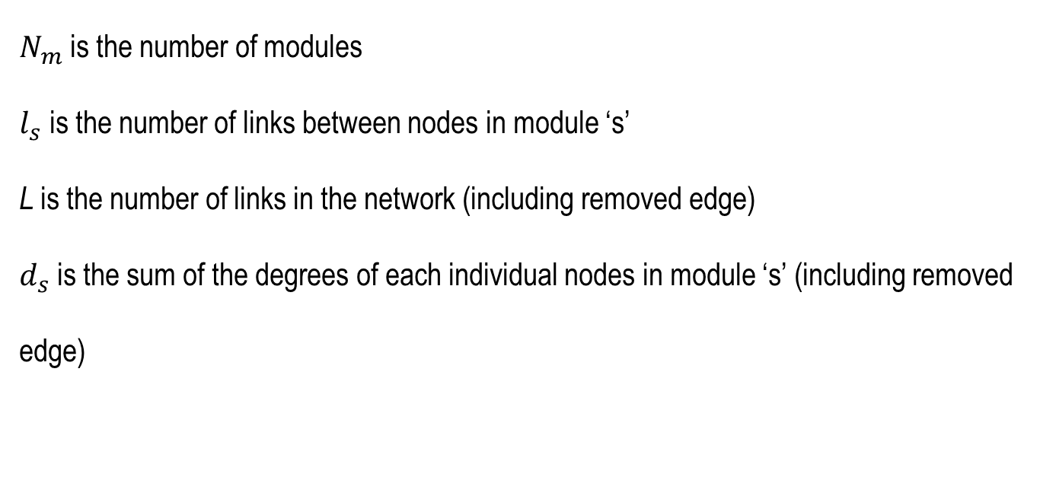
$N_{m}$ is the number of modules
$l_{s}$is the number of links between nodes in module ‘s’
L is the number of links in the network (including removed edge)
$d_{s}$ is the sum of the degrees of each individual nodes in module ‘s’ (including removed edge)

Slide 14
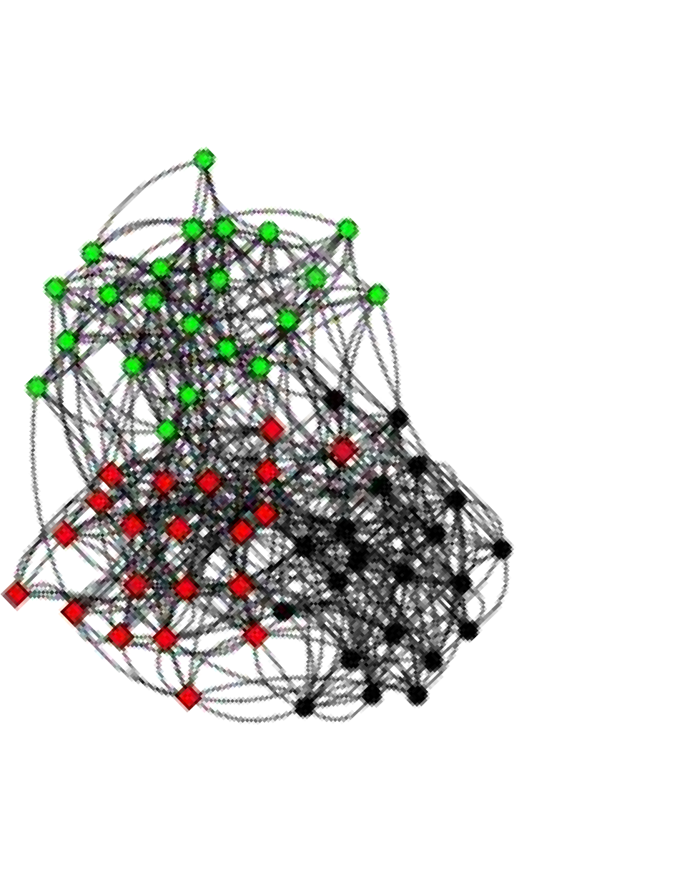
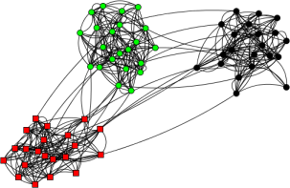
modularity - example
In a random graph (ER model), we expect that any possible partition would lead to Q = 0.
Typically, in non-random graphs modularity takes values between positive values 0.3 to 0.7.
fuzzy communities Q = 0.37
Q = 0.60
clear community structure

Slide 15

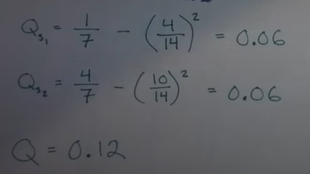
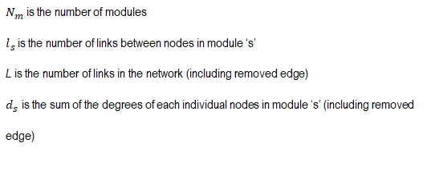
Example
S1
S2

Slide 16
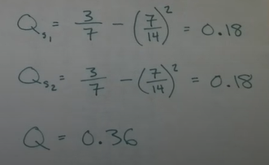

Example
S1
S2

Slide 17
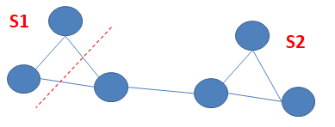
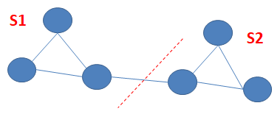
Which random graph cut gives maximum modularity????

Slide 18
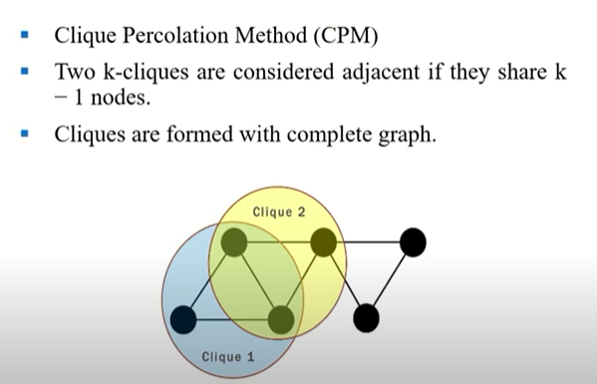

Slide 19
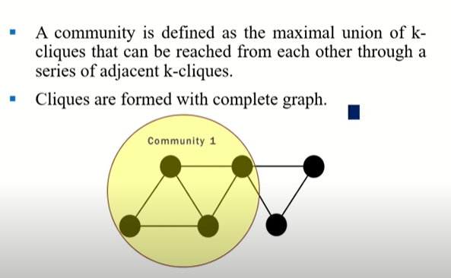

Slide 20
Clique Percolation Method
Clique is a very strict definition, unstable
Normally use cliques as a core or a seed to find larger communities
CPM is such a method to find overlapping communities
Input
A parameter k, and a network
Procedure
Find out all cliques of size k in a given network
Construct a clique graph. Two cliques are adjacent if they share k- 1 nodes
Each connected components in the clique graph form a
community
20

Slide 21
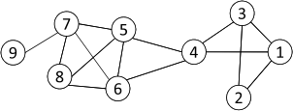




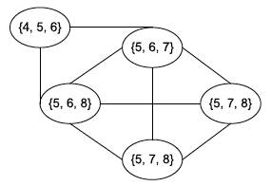



CPM Example
Cliques of size 3:
{1, 2, 3}, {1, 3, 4}, {4, 5, 6},
{5, 6, 7}, {5, 6, 8}, {5, 7, 8},
{6, 7, 8}
Communities:
{1, 2, 3, 4}
{4, 5, 6, 7, 8}
38

Slide 22
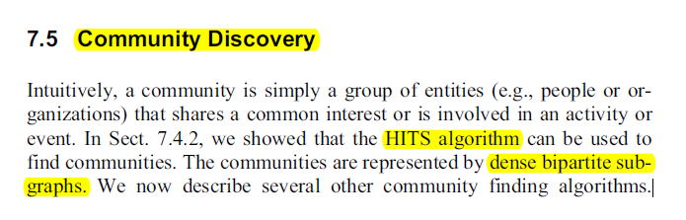

Slide 23
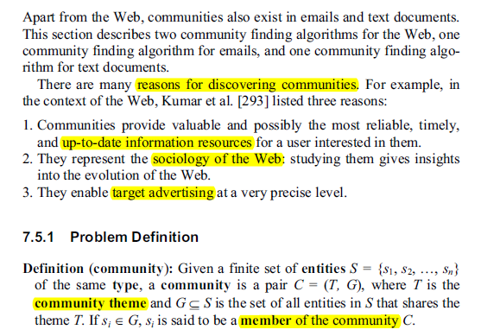

Slide 24
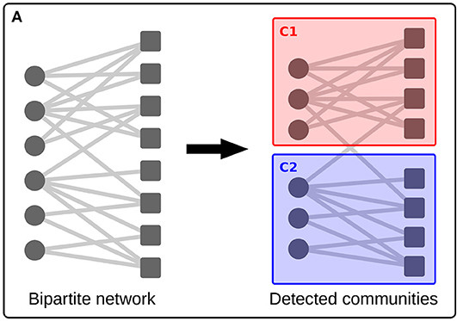

Slide 25
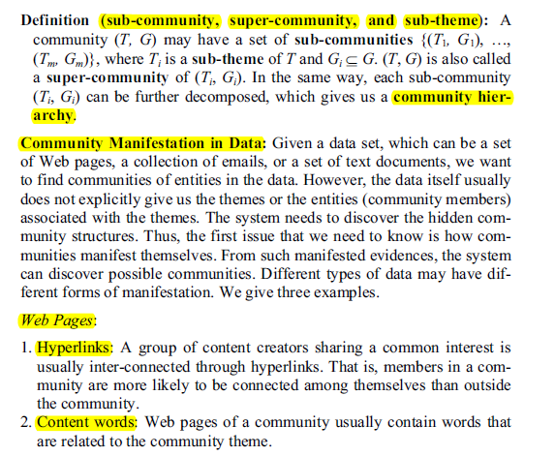

Slide 26
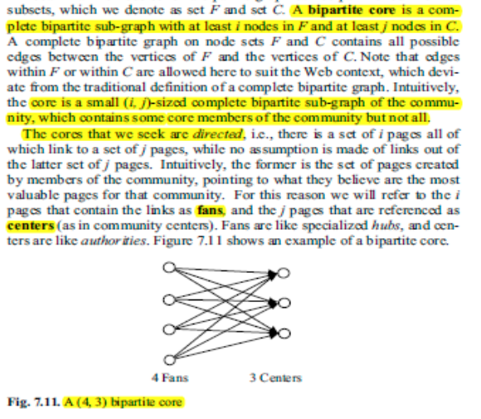

Slide 27
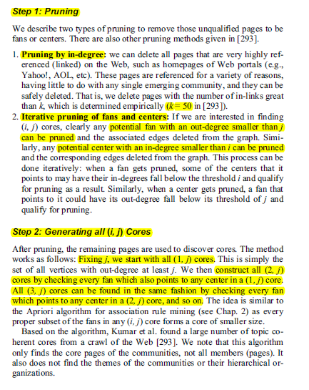
Algorithm

Slide 29


questions
75

